Slide 1

COVID-19
August 2020 - The Bridge
INSTRUCTOR: Gabriel Vázquez Torres
gabriel@thebridgeschool.es
TEACHER: Clara Piniella Martinez
clara.piniella@thebridgeschool.es
GROUP PROJECT - AUGUST 2020
GROUP ‘A’:
Natalio Altube
Tomás Lizarazo
Rosario Marianeschi
Elsa Toribio

Slide 2
CONTENTS
In this 7-minute presentation, we’ll show our Project based on the following tasks:
A group ID was generated as the “N” number: A137 (Letter plus the sum of all participant’s ages)
A token ID value was also created, called “S” number: ‘A249191580208185295299619560’
Out of the information in real time from https://ourworldindata.org/coronavirus-source-data , ‘https://covid.ourworldindata.org/data/owid-covid-data.csv’ we created a final dataframe of ‘c_averages’ that represents the mean of the “new_cases” in all of your countries: Argentina, Chile, Colombia, Russia & Spain.
The API created, would show on the request screen a json file with one key: ‘c_averages’

Slide 3
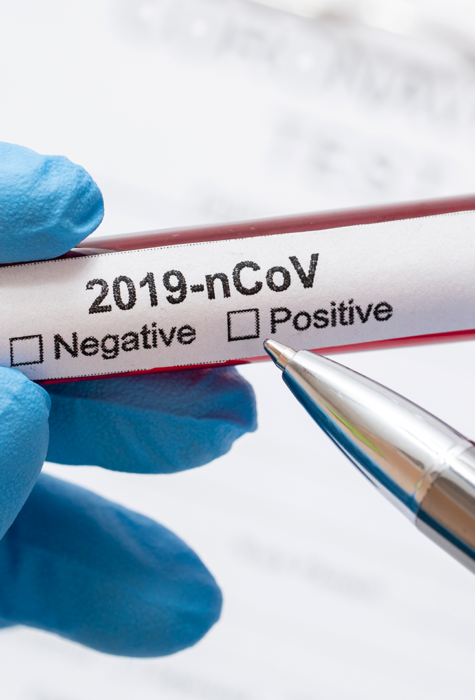
WE CREATED THE API
We used [“GET”] methodology to define 2 functions:
1st: Accessing with the group ID, you can obtain the token id. EndPoint of this function: =/get_token/
http://192.168.0.116:6060/get_token/?id=A137

Slide 4
YOU’LL SEE ON THE SCREEN THE FOLLOWING TOKEN:
{ "token": "A2491921306645144496740293228” }

Slide 5
WE CREATED THE API
2nd: With that token id, you can access the .json file on the screen.
http://192.168.0.116:6060/get_token/?id=A137
These are the particular IP addresses from the A Team members’:
192.168.0.116:6060/ (Rosario) 192.168.0.72:6060/ (Elsa) 192.168.0.80:6060/ (Tomás) 192.168.0.45:6060/ (Natatio)

Slide 6
YOU’LL SEE ON THE SCREEN THE FOLLOWING .json:
{"c_averages": {"2019-12-31": 0.0, "2020-01-01": 0.0, "2020-01-02": 0.0, "2020-01-03": 0.0, "2020-01 -04 ": 0.0," 2020-01-05 ": 0.0," 2020-01-06 ": 0.0," 2020-01-07 ": 0.0," 2020-01-08 ": 0.0," 2020-01 -09 ": 0.0," 2020-01-10 ": 0.0," 2020-01-11 ": 0.0," 2020-01-12 ": 0.0," 2020-01-13 ": 0.0," 2020-01 -14 ": 0.0," 2020-01-15 ": 0.0," 2020-01-16 ": 0.0," 2020-01-17 ": 0.0," 2020-01-18 ": 0.0," 2020-01 -19 ": 0.0," 2020-01-20 ": 0.0," 2020-01-21 ": 0.0," 2020-01-22 ": 0.0," 2020-01-23 ": 0.0," 2020-01 -24 ": 0.0," 2020-01-25 ": 0.0," 2020-01-26 ": 0.0," 2020-01-27 ": 0.0," 2020-01-28 ": 0.0," 2020-01 -29 ": 0.0," 2020-01-30 ": 0.0, "2020-01-31": 0.0, "2020-02-01": 1.5, "2020-02-02": 0.0, "2020-02-03": 0.0, "2020-02-04": 0.0, "2020-02-05": 0.0, "2020-02-06": 0.0, "2020-02-07": 0.0, "2020-02-08": 0.0, "2020-02-09": 0.0, "2020-02-10": 0.5, "2020-02-11": 0.0, "2020-02-12": 0.0, "2020-02-13": 0.0, "2020-02-14": 0.0, "2020-02-15": 0.0, "2020-02-16": 0.0, "2020-02-17": 0.0, "2020-02-18": 0.0, "2020-02-19": 0.0, "2020-02-20": 0.0, "2020-02-21": 0.0, "2020-02-22": 0.0, "2020-02-23": 0.0, "2020-02-24": 0.0, "2020-02-25": 0.5, "2020-02-26": 3.0, "2020-02-27": 4.0, "2020-02-28": 9.0, "2020-02-29": 9.5, "2020-03-01": 14.0, "2020-03-02 ": 27.0," 2020-03-03 ": 28.5," 2020-03-04 ": 19.5," 2020-03-05 ": 27.67," 2020-03-06 ": 46.25," 2020-03-07 ": 49.4," 2020-03-08 ": 110.33," 2020-03-09 ": 110.25," 2020-03-10 ": 194.25," 2020-03-11 ": 246.5," 2020-03-12 ": 295.0," 2020-03-13 ": 389.5," 2020-03-14 ": 343.6," 2020-03-15 ": 441.0," 2020-03-16 ": 349.2," 2020-03-17 ": 527.0," 2020-03-18 ": 756.4," 2020-03-19 ": 834.4," 2020-03-20 ": 956.4," 2020-03-21 ": 1130.4," 2020-03-22 ": 1028.2," 2020-03-23 ​​": 987.8," 2020-03-24 ": 1582.2," 2020-03-25 ": 1788.8," 2020-03-26 ": 1908.8," 2020-03-27 ": 1927.0," 2020-03-28 ": 1778.6," 2020-03-29 ": 1415.0," 2020-03-30 ": 1296.4,"2020-03-31 ": 1799.8," 2020-04-01 ": 1662.2," 2020-04-02 ": 1728.4," 2020-04-03 ": 1702.4," 2020-04-04 ": 1567.0," 2020-04-05 ": 1372.8," 2020-04-06 ": 963.4," 2020-04-07 ": 1335.0," 2020-04-08 ": 1465.2," 2020-04-09 ": 1540.8," 2020-04-10 ": 1338.0," 2020-04-11 ": 1439.2," 2020-04-12 ": 1278.0," 2020-04-13 ": 1127.0," 2020-04-14 ": 1226.2," 2020-04-15 ": 1575.4," 2020-04-16 ": 1538.0," 2020-04-17 ": 1611.2," 2020-04-18 ": 1731.0," 2020-04-19 ": 980.4," 2020-04-20 ": 1781.8," 2020-04-21 ": 1582.6," 2020-04-22 ": 1712.6," 2020-04-23 ": 1793.4," 2020-04-24 ": 1551.2," 2020-04-25 ": 1833.8," 2020-04-26 ": 1752.8," 2020-04-27 ": 1746.2," 2020-04-28 ": 1729.2, "2020-04-29": 1657.2, "2020-04-30": 1604.4, "2020-05-01": 2012.6, "2020-05-02": 2151.0, "2020-05-03": 2482.6, "2020-05-04": 2562.4, "2020-05-05": 2601.8, "2020-05-06": 2625.6, "2020-05-07": 2609.2, "2020-05-08": 2919.4, "2020-05-09": 2733.6, "2020-05-10": 3217.8, "2020-05-11": 2726.6, "2020-05-12": 2826.0, "2020-05-13": 2836.8, "2020-05-14": 2902.2, "2020-05-15": 2842.2, "2020-05-16": 2913.2, "2020-05-17": 2557.4, "2020-05-18": 2590.6, "2020-05-19": 2584.4, "2020-05-20": 2875.8, "2020-05-21": 2902.0, "2020-05-22": 3178.2, "2020-05-23": 3031.0, "2020-05-24": 3040.4, "2020-05-25": 2731.4, "2020-05-26": 3211.6, "2020-05-27 ": 3002.2," 2020-05-28 ": 3121.8," 2020-05-29 ": 3142.8," 2020-05-30 ": 2994.0," 2020-05-31 ": 3143.2," 2020-06-01 ": 3218.2," 2020-06-02 ": 3294.8," 2020-06-03 ": 3005.6," 2020-06-04 ": 3256.4," 2020-06-05 ": 3115.8," 2020-06-06 ": 3309.8," 2020-06-07 ": 3343.2," 2020-06-08 ": 3507.8," 2020-06-09 ": 3247.8," 2020-06-10 ": 3064.4," 2020-06-11 ": 3482.2," 2020-06-12 ": 3250.0," 2020-06-13 ": 4140.8," 2020-06-14 ": 3791.4," 2020-06-15 ": 3885.8," 2020-06-16 ": 3388.0," 2020-06-17 ": 3371.6," 2020-06-18 ": 9623.0," 2020-06-19 ": 3148.6," 2020-06-20 ": 4340.4," 2020-06-21 ": 3513.8," 2020-06-22 ": 3633.4," 2020-06-23 ": 3426.6," 2020-06-24 ":2790.4, "2020-06-25": 3937.2, "2020-06-26": 3654.4, "2020-06-27": 3100.6, "2020-06-28": 4199.0, "2020-06-29": 2877.0, "2020-06-30": 3767.0, "2020-07-01": 3108.0, "2020-07-02": 3296.0, "2020-07-03": 3309.0, "2020-07-04": 3301.2, "2020-07-05": 2854.8, "2020-07-06": 3595.2, "2020-07-07": 3117.4, "2020-07-08": 3211.6, "2020-07-09": 3258.4, "2020-07-10": 3886.6, "2020-07-11": 4031.8, "2020-07-12": 3463.8, "2020-07-13": 4040.8, "2020-07-14": 3251.6, "2020-07-15": 3545.8, "2020-07-16": 3682.2, "2020-07-17": 4521.6, "2020-07-18": 5607.6, "2020-07-19": 3837.4, "2020-07-20": 3754.6, "2020-07-21": 4071.0, "2020-07-22": 3981.0, "2020-07-23 ": 4586.0," 2020-07-24 ": 4837.4," 2020-07-25 ": 4330.2," 2020-07-26 ": 4181.2," 2020-07-27 ": 6302.2," 2020-07-28 ": 3544.2," 2020-07-29 ": 4895.4," 2020-07-30 ": 5464.75}}

Slide 7
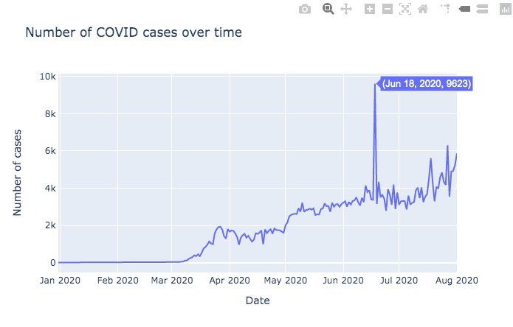
01. Option C
Our countries:
Argentina
Chile
Colombia
Russia
Spain
We got the .json file from Group D. They represented “t_d_averages”, which is the mean of the “total_deaths” of all of their countries.
Of course it shows different trends for each column compared to our dataset…
WHY??
-Because they have information from different countries. Their group of 5 countries only has 1 country in common.
-They calculated the mean of total deaths due to COIVD19, whereas we calculated the mean of New Cases detected.

Slide 8
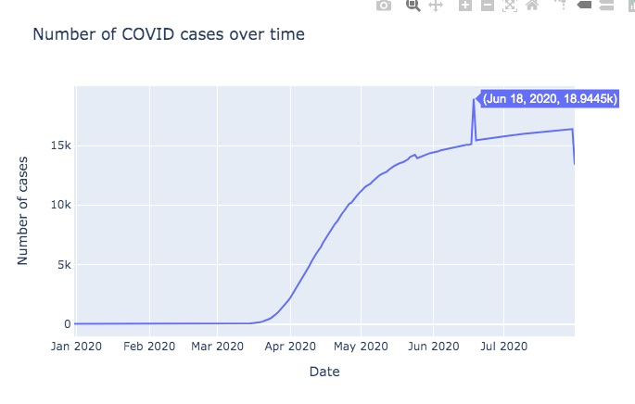
Show, vertically, the start and end date of the alarm state in Group D’s countries:
Group D’s countries:
Portugal
Spain
Turkey
UK
Venezuela

Slide 9
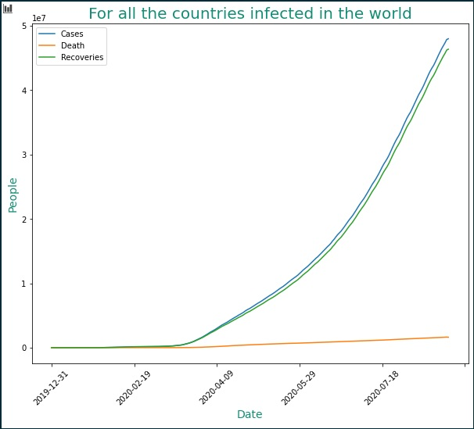
ALL THE COUNTRIES INFECTED IN THE WORLD
The graph shows the following numbers for all the countries:
Total infected
Total deaths
Total recoveries

Slide 10
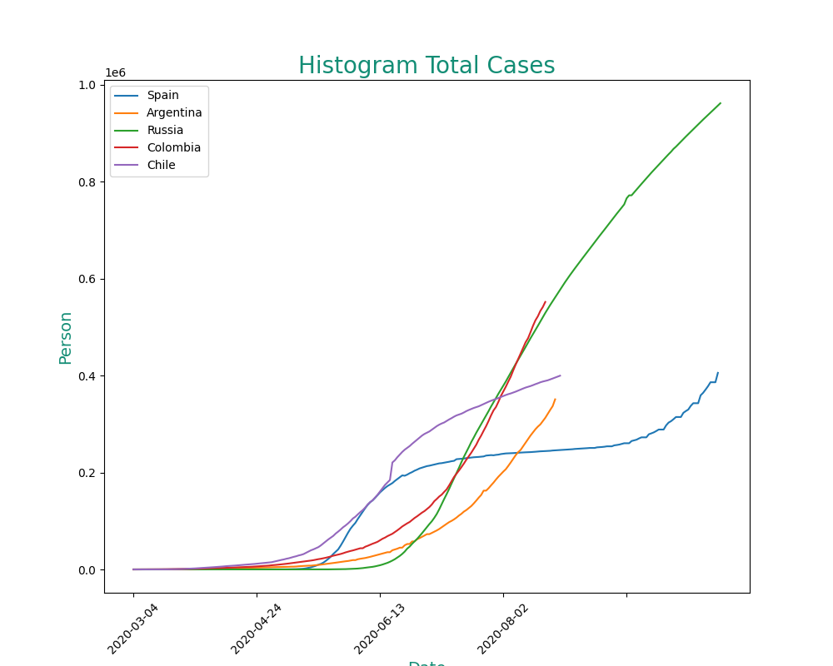
OUR GROUP OF COUNTRIES
Position of Argentina, Chile, Colombia, Russia & Spain, in terms of:
Total infected/New Cases

Slide 11
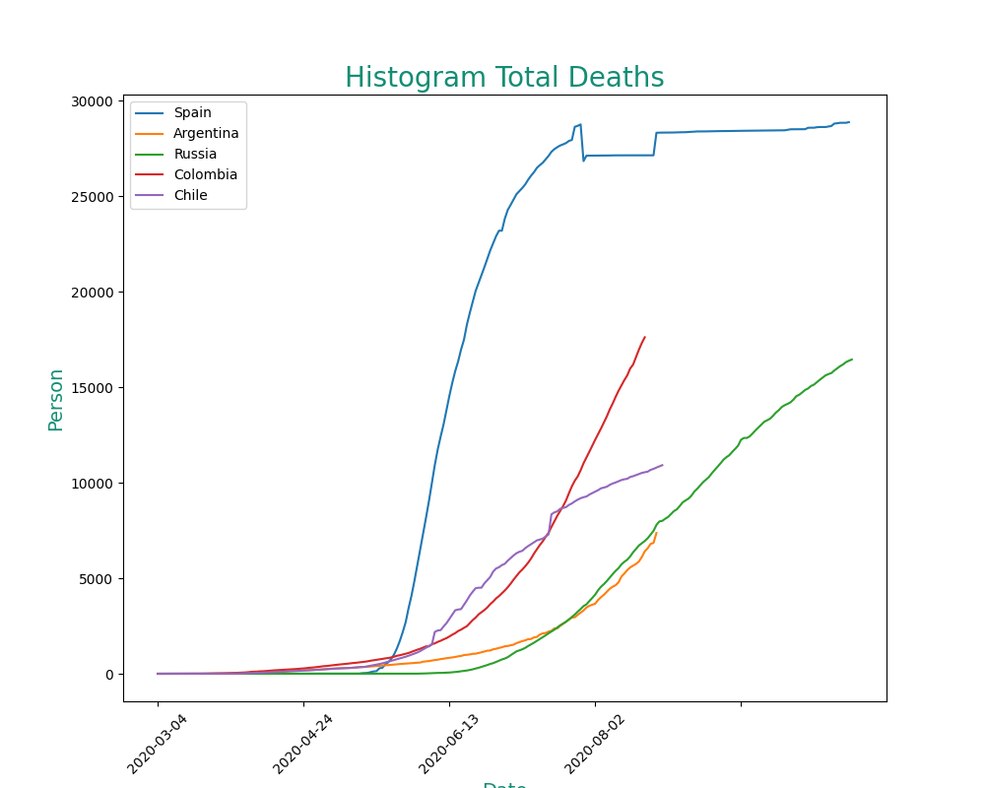
OUR GROUP OF COUNTRIES
Position of Argentina, Chile, Colombia, Russia & Spain, in terms of:
Total Deaths

Slide 12
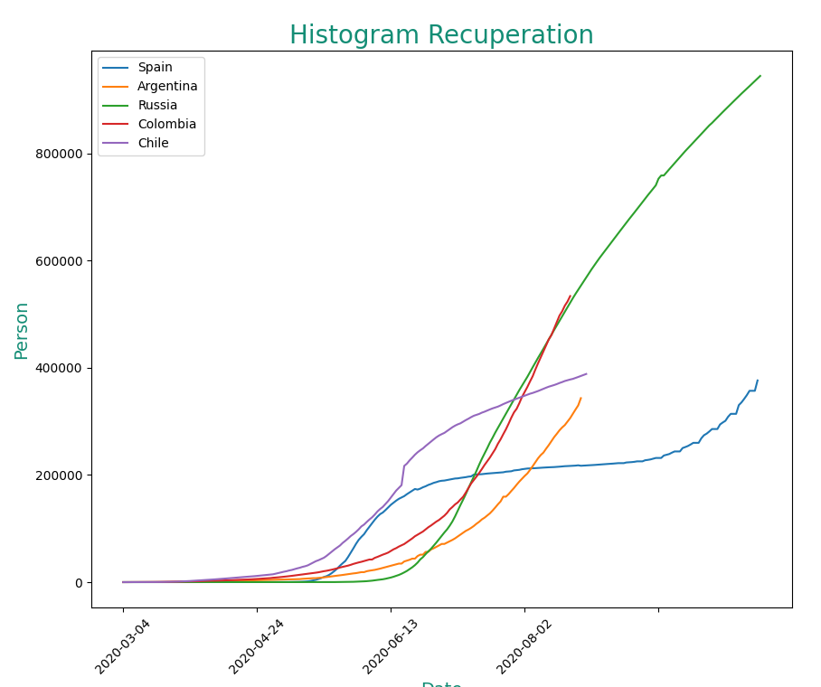
OUR GROUP OF COUNTRIES
Position of Argentina, Chile, Colombia, Russia & Spain, in terms of:
Total Recoveries

Slide 13
STATS FOR THE 5 COUNTRIES
Mean of Cases for each country
Argentina 1970
Chile 2150
Colombia 3095
Russia 5190
Spain 2285

Slide 14
Conclusions about our data study - Outliers & rare data
Argentina – Aug 25th = 14.065 Colombia – Aug 20th = 13.056 Chile – Jun 18th = 36.179 Russia – July 18th = 12.640 Spain – Aug 24th = 19.382
3.240
Mean of New Reported Cases within the 5 countries of our Group work, PER DAY, since January 2020 up to present.
Maximum Peaks of COVID19 Positive cases

Slide 15
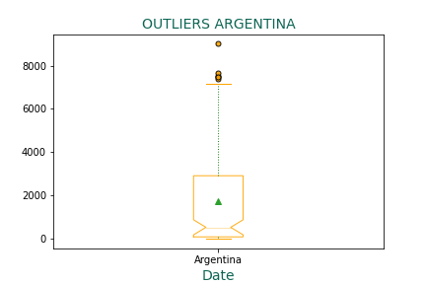
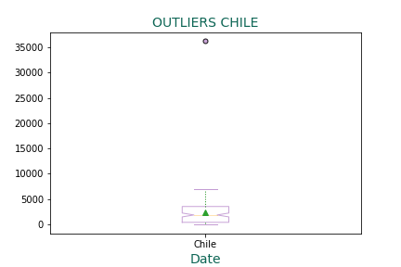
OUTLIERS
Argentina
Chile

Slide 16
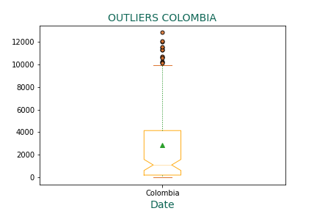
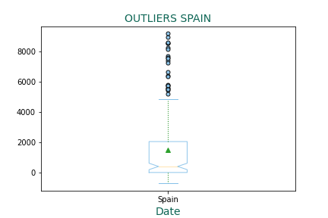
OUTLIERS
Colombia
Spain

Slide 17
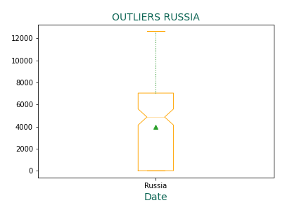
OUTLIERS
Russia

Slide 18
02. Option B
Draw, in different colors and vertically, the moments when the daily death curve increases and decreases.
Create with bars, lines, points and pie charts the daily deaths and infected.

Slide 19
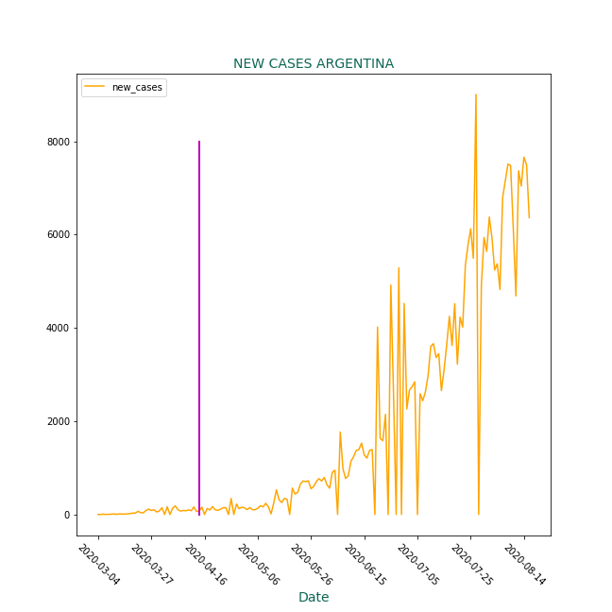
Argentina: July 27th
Moments when the Daily curves Increases and decreases

Slide 20
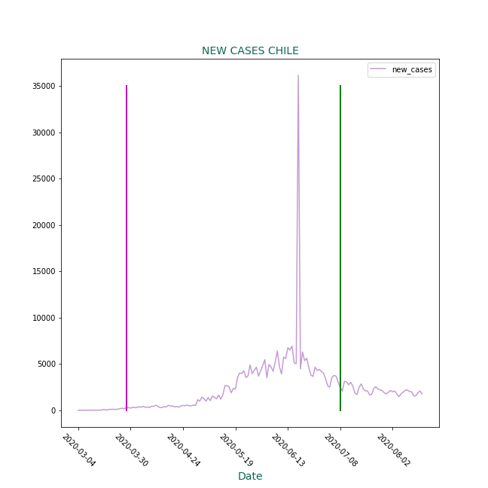
Chile: June 18th
Moments when the Daily curves Increases and decreases

Slide 21
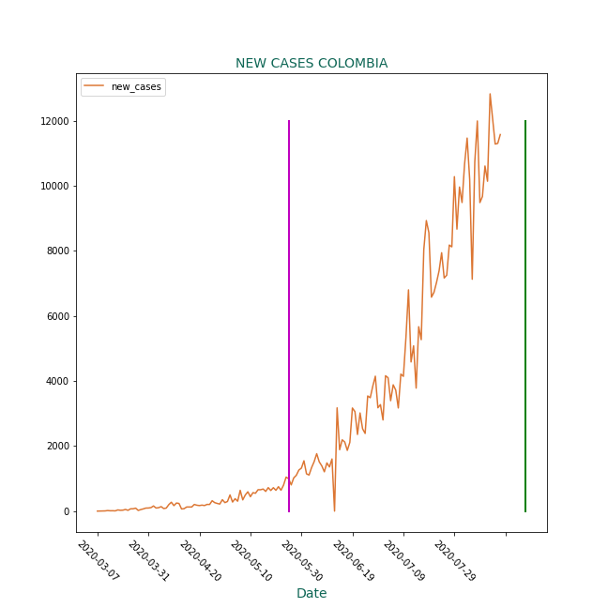
Colombia: August 20th
Moments when the Daily curves Increases and decreases

Slide 22
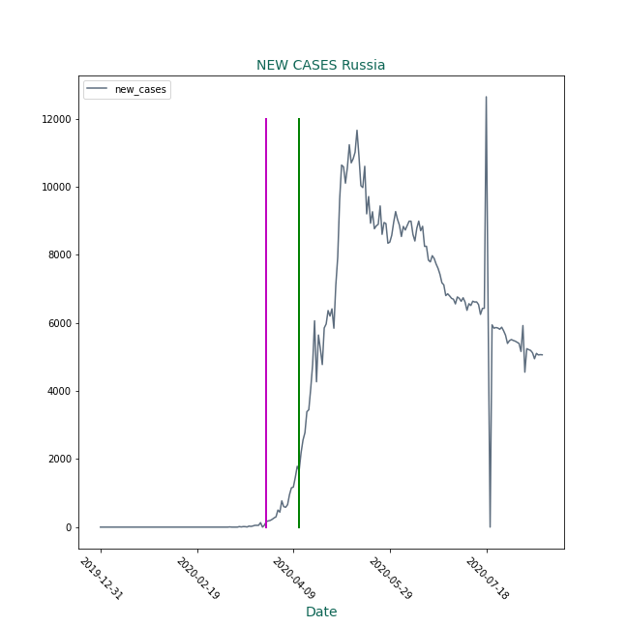
Russia: May 20th
Moments when the Daily curves Increases and decreases

Slide 23
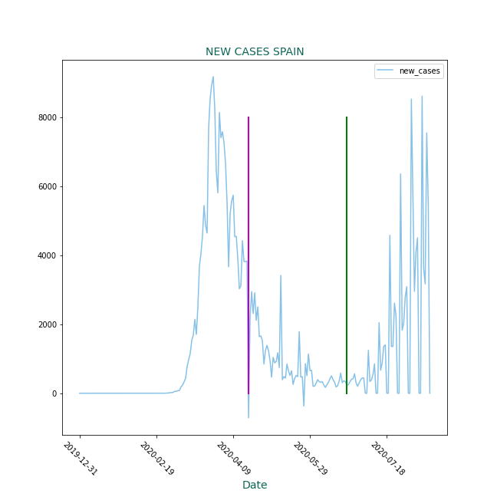
Spain: March 27th
Moments when the Daily curves Increases and decreases

Slide 24
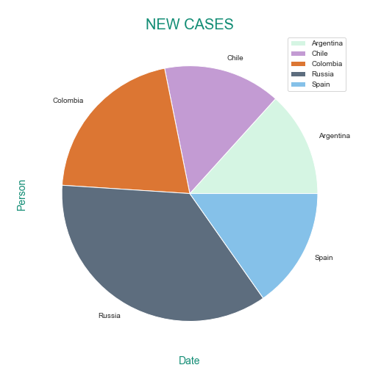
PIE CHART
New cases in our 5 countries:
Argentina
Chile
Colombia
Russia
Spain

Slide 25
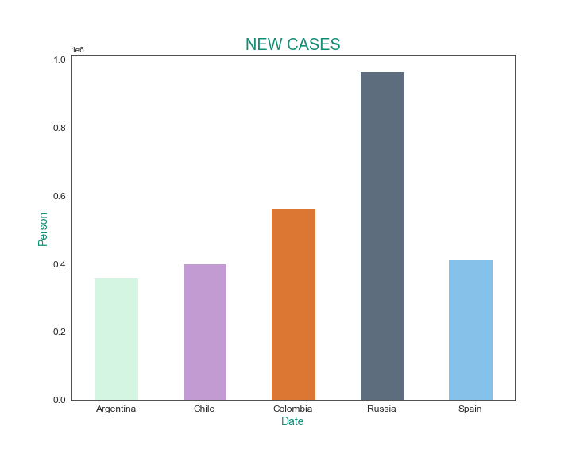
BARS
New cases in our 5 countries:
Argentina
Chile
Colombia
Russia
Spain

Slide 26
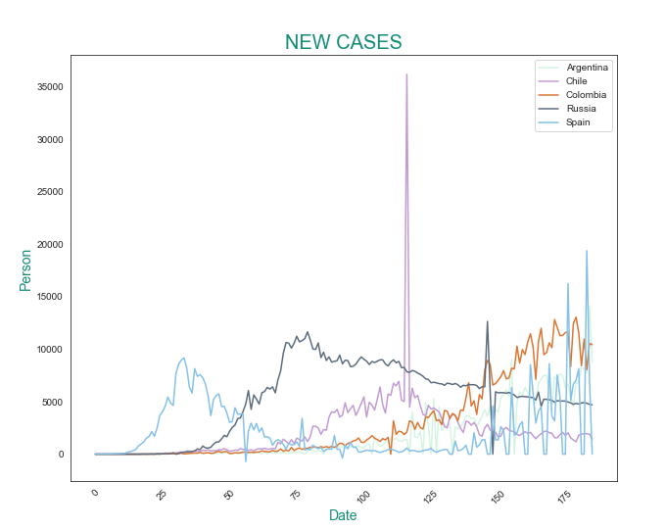
BARS
Total cases in our 5 countries:
Argentina
Chile
Colombia
Russia
Spain

Slide 27
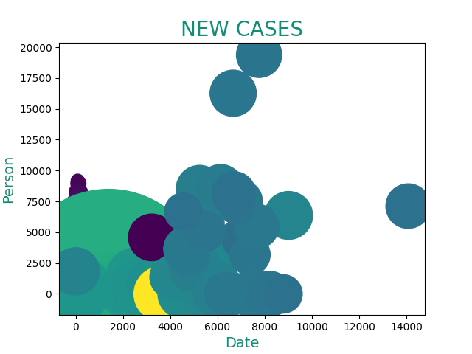
POINTS
Total cases in our 5 countries:
Argentina
Chile
Colombia
Russia
Spain

Slide 28
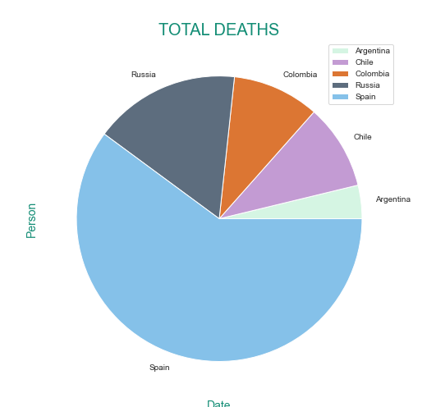
PIE CHART
Total death in our 5 countries
Argentina
Chile
Colombia
Russia
Spain

Slide 29
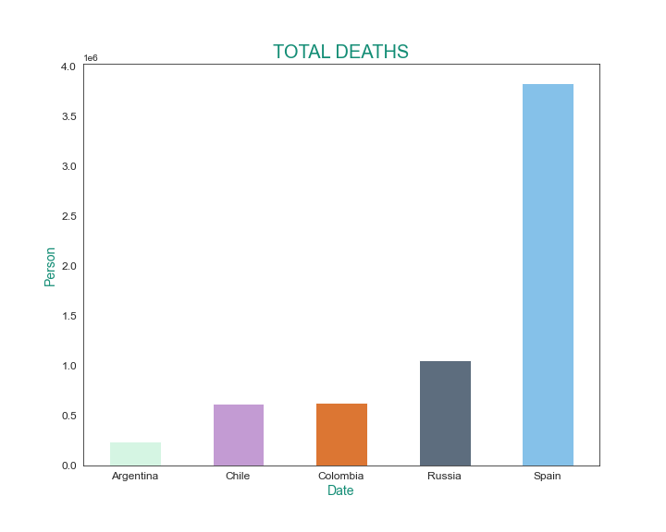
BARS
Total death in our 5 countries:
Argentina
Chile
Colombia
Russia
Spain

Slide 30
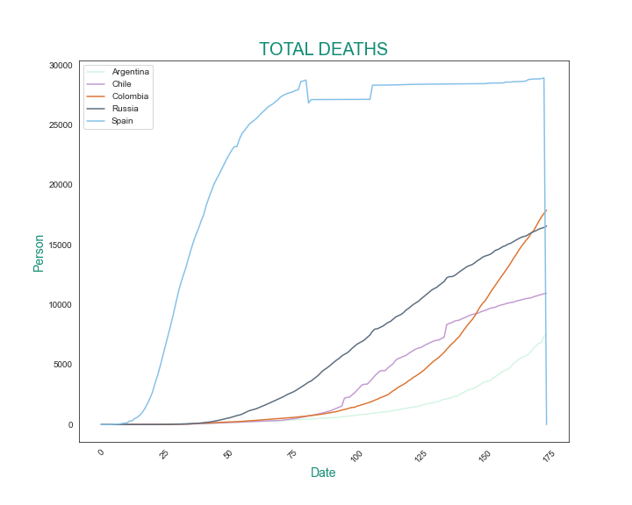
LINES
Total death in our 5 countries:
Argentina
Chile
Colombia
Russia
Spain

Slide 31
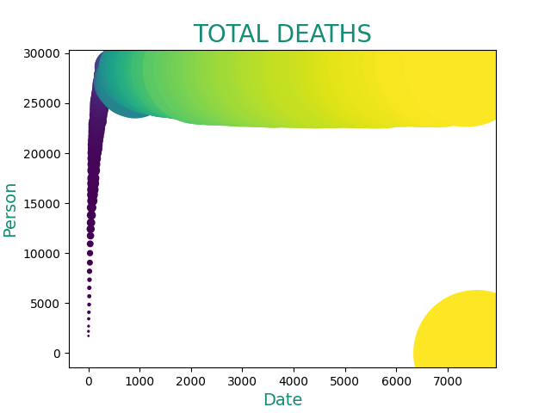
POINTS
Total death in our 5 countries
Argentina
Chile
Colombia
Russia
Spain

Slide 32
Countries from our Group A
 | Total NEW CASES | TOTAL DEATHS
Argentina | 370175 | 7839
Chile | 402365 | 10990
Colombia | 572270 | 18184
Spain | 419849 | 28971
Russia | 970865 | 16683

Slide 33
2,735,524
0,03%
Reported cases of COVID-19 in our 5 countries
82,667
Reported death of COVID-19 in our 5 countries as of August 2020
Mortality percentage as of August 2020

Slide 34
03. Option A
2. Use distribute modules for each functionality. The jupyter notebooks must not have any loop or function definitions. It only must have the initials imports and the call tonecessary functions.
3. Can we conclude that the alarm state has had an effect on the improvement
of the daily infected rate? explain why (we know it is more complex of what
you can explain with your data).
Research to save each plot in local files. Save them on different folders for each country.

Slide 35
The alarm state shows a little improvement on the daily infected rate, at the beginning, but it’s not very consistent. If we had to mention a correlation: it would be negative. When the alarm state starts: Cases are at their highest. Then they start decreasing as the alarm state is carried out. Then they tend to stabilize, the alarm state is released and cases start to climb up again..

Slide 36
03. Option A+
Here you could describe the topic of the section

Slide 37
—DR. TEDROS ADHANOM GHEBREYESUS, WORLD HEALTH ORGANIZATION’S DIRECTOR GENERAL
“We cannot say this loudly enough or clearly enough or often enough: All countries can still change the course of this pandemic”

Slide 38
COVID-19
COVID-19 is an infectious disease caused by the recently found virus known as SARS-CoV-2 (or coronavirus). Before the outbreak originated in Wuhan, China on December 2019, there was no information about this virus

Slide 39
HISTORY
The oldest common ancestor of coronavirus has been dated as far back as the 9th century BC. Some studies published in 1990 specified the most recent common ancestors as follows:
Betacoronavirus: 3300 BC
Deltacoronavirus: 3000 BC
Gammacoronavirus: 2800 BC
Alphacoronavirus: 2400 BC

Slide 40
ABOUT CORONAVIRUS
here if you need it

Slide 41
SYMPTOMS OF COVID-19
HIGH FEVER
TIREDNESS
DRY COUGH
The body temperature can exceed 37.3 Celsius degrees or 99 Fahrenheit degrees
The body feels completely tired and without energy to perform normal tasks
Irritation and constant coughing without expelling any mucus

Slide 42
PREVENTION MEASURES
You could enter a subtitle here if you need it

Slide 43
PROTECTING YOURSELF AND PREVENTING THE SPREAD OF THE DISEASE
Wash your hands with an alcohol-based sanitizer or with soap and water
Keep a distance of at least 1 meter between yourself and anyone who coughs or sneezes
Try your best not to touch your eyes, your nose and your mouth
Cover your mouth and your nose with your bent elbow or a tissue when coughing
Seek medical attention if you have difficulty breathing and a high fever
Follow the directions of your national or local health authorities

Slide 44
PROTECTION MEASURES FOR PEOPLE THAT ARE IN OR VISITED INFECTED AREAS
01
02
Stay home if you do not feel well, even if you feel mild symptoms such as headaches, slight fever and a runny nose
If you need to go out (for example, to buy food or supplies), wear a mask to minimize the risk of infecting others
03
04
If you have difficulty breathing and/or a high fever, seek medical advice as soon as possible
Call your provider and inform them of any recent travel, especially to countries with reported cases

Slide 45

ABOUT 80% OF PEOPLE RECOVER FROM THIS DISEASE WITHOUT NEEDING SPECIAL TREATMENT

Slide 46
WHAT TO DO IF YOU DON’T FEEL WELL
STEP 04
Patiently wait for the results of the test
STEP 05
Follow the instructions provided by the doctor

Slide 47
THANKS!
Do you have any questions?

Slide 48
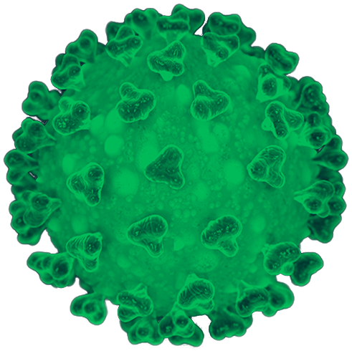
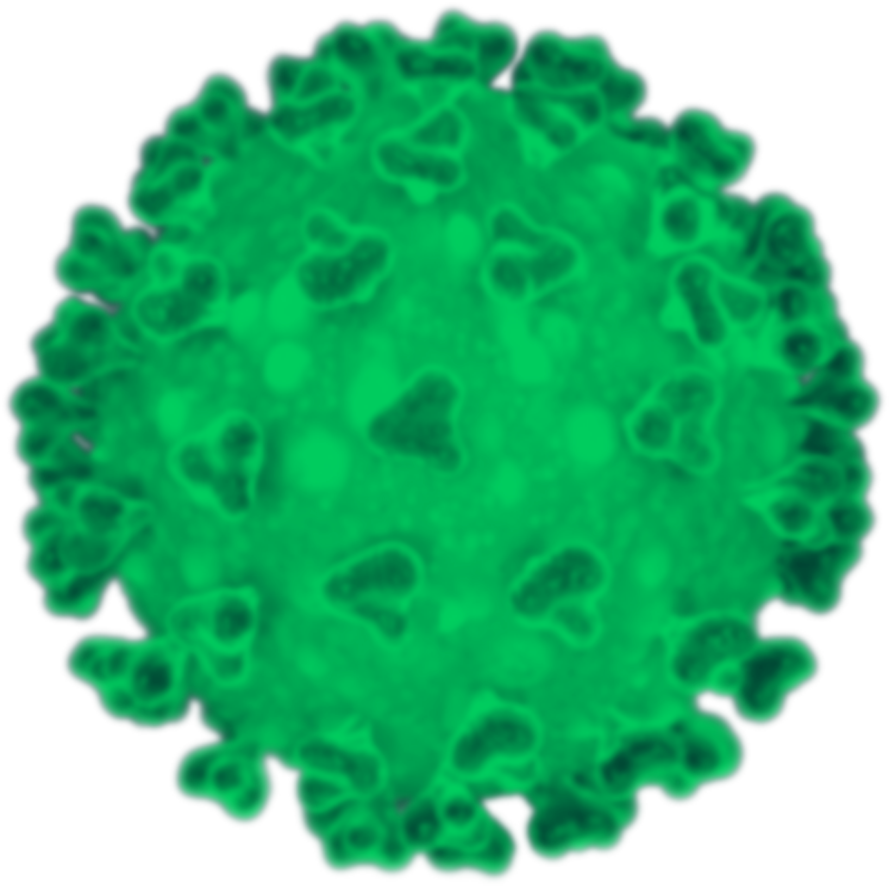


ALTERNATIVE RESOURCES

